Slide 1
Problem Statement
Innovative Monitoring System for Tele ICU Patients Using Video Processing and Deep Learning

Slide 2
Unique Idea Brief (Solution)
Developing an innovative monitoring system for Tele ICU patients using video processing and deep learning involves designing a robust system architecture and implementing various technologies. The system would start with high-resolution cameras installed in ICU rooms to capture continuous video feeds of patients. These feeds would be initially processed by local edge devices to reduce latency and bandwidth usage. The processed video data would then be transmitted to a central server, where deep learning models analyze the footage for vital sign monitoring, anomaly detection, and predictive analytics. A user-friendly interface would be developed for healthcare providers to monitor patients remotely, view real-time alerts, and access detailed patient data. This solution aims to improve patient monitoring by detecting early signs of deterioration, allowing for timely interventions and ultimately enhancing patient outcomes.

Slide 3
Features Offered
The innovative monitoring system for Tele ICU patients using video processing and deep learning offers several advanced features designed to enhance patient care and improve clinical outcomes.
Continuous Real-Time Monitoring
Vital Sign Extraction
Facial Recognition and Emotion Analysis
Integration with Electronic Health Records (EHR)
Real-Time Alerts and Notifications
Data Privacy and Security
Customizable Dashboards

Slide 4
Process flow
Requirement Gathering and Analysis
System Design
Data Collection and Preparation
Model Development
System Integration
User Interface Development
Testing and Validation
Deployment

Slide 5
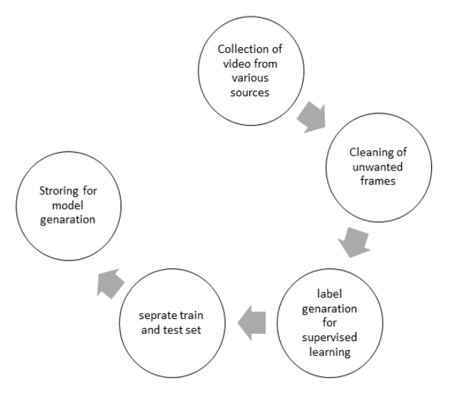
Architecture Diagram

Slide 6
Technologies used
Internet of Things (IoT)
High-Resolution Video Conferencing
Artificial Intelligence (AI) and Machine Learning (ML)
Cloud Computing
Big Data Analytics
Bedside Monitors
Communication and Networking Equipment
Robotic Systems
Diagnostic Equipment

Slide 7
Conclusion
In conclusion, the development of an innovative monitoring system for Tele ICU patients using video processing, deep learning, and Arduino technology represents a significant advancement in remote patient care. This system combines high-resolution video feeds with data from Arduino-connected sensors to provide continuous, real-time monitoring of patients. By leveraging deep learning models for vital sign extraction, anomaly detection, and activity recognition, the system enhances the ability of healthcare providers to detect early signs of deterioration and intervene promptly. Throughout the development process, emphasis on data privacy, regulatory compliance, and scalability ensures that the system is robust, secure, and adaptable to various ICU environments.

